Slide 1

Capstone Project – The Battle of Neighborhood
Finding a new location for opening a Japanese Restaurant in Toronto
Alan Ng

Slide 2
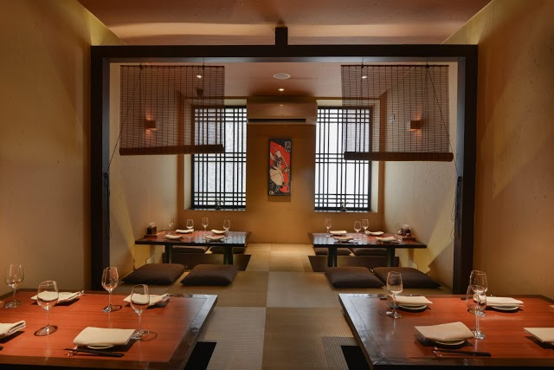
Introduction
find an optimal place for a Japanese Restaurant in Toronto
not packed with restaurants
not containing many Japanese restaurants to reduce competition.

Slide 3
Data
Toronto Neighborhoods from Wikipedia: basic information about the neighborhoods
Venue Data from Foursquare API: the number of restaurants and their type and location in every neighborhood
Location data from Geocoder Package: Geographical coordinates of the neighborhoods.

Slide 4
Methodology: Data Cleansing
Data of Toronto Neighborhood is scrapped from the Wikipedia
Cells with a borough “Not assigned” will not be processed
Merged the neighborhood if more than 1 neighborhood in 1 Postal Code
Geographical coordinates are retrieved from a csv file and the coordinates are combined with the data frame above.
Venue data would be retrieved from Foursquare API for each neighborhood.
Average Japanese Restaurant of each neighborhood would be retrieved

Slide 5
Methodology: Machine Learning
used is k-mean clustering algorithm
The neighborhoods are clustered based on similar Japanese Restaurants in that neighborhood
neighborhood is clustered into 5 clusters

Slide 6
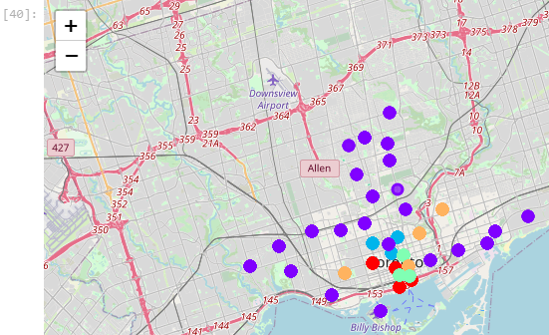
Results: Map
Cluster 1: Purple
Cluster 2: Blue
Cluster 3: Green
Cluster 4: Orange
Cluster 5: Red

Slide 7
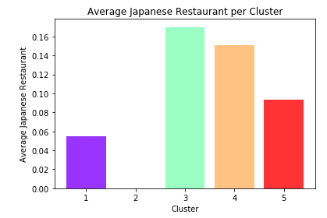
Results: Average Japanese Restaurant per Cluster
there is no Japanese Restaurant in Cluster 2
the most and second most Japanese Restaurant on average are in Cluster 3 and Cluster 4

Slide 8
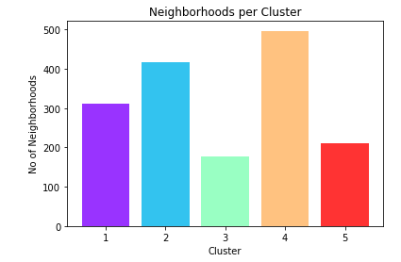
Results: Neighborhoods per Cluster
Cluster 3 contains the least neighborhood
Cluster 4 and Cluster 2 contains the most and second most neighborhoods

Slide 9
Discussion
Cluster 2 seems a good choice
No Japanese Restaurant: less competition
Contains the 2nd most neighborhoods: ensure enough customers for choices
Worthwhile to look at Cluster 2
Choose near college area in Cluster 2, to have better potential customers
exchange students from different countries
college students: more likely to try different cuisine
young adults: more willing to pay for food

Slide 10
Conclusion
The complex problem is decomposed into different smaller problems
Different source of data is retrieved and cleansed
The data then to be trained using k-mean algorithm to have different clusters
Eliminate the clusters unwanted and only investigate the cluster of interest, in this case Cluster 2

Slide 11
Conclusion: Continued
Investigate Cluster 2 to identify a more specific area for opening the Japanese Restaurant.
After investigating the potential customers, area near college area in Cluster 2 seems the best for opening the business
Improvement: include more data related to population to better identify the potential customers and develop a better strategy to maintain the business

Slide 12
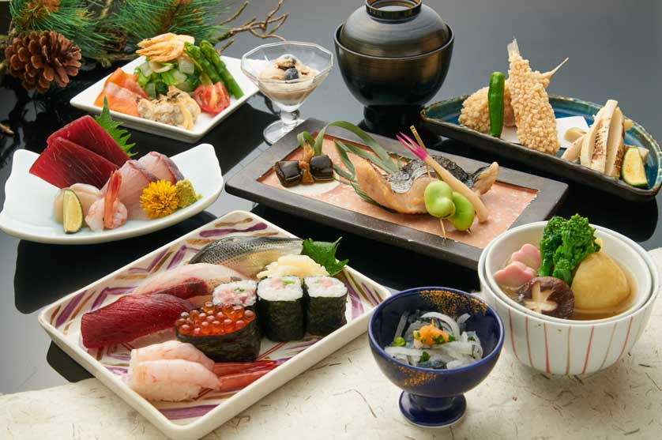
END

